Slide 1
How to Use ISO27002:2013
What is ISO27002:2013 ?
Information technology -- Security techniques -- Code of practice for information security controls
Renamed from ISO 17799

Slide 2
How to Use ISO27002:2013
0.1 Background & Context
This Int’l Standard is designed for orgs to use as a reference for selecting controls within the process of implementing an Information Security Management System (ISMS) based on ISO/IEC 27001;

Slide 3
How to Use ISO27002:2013
0.1 Background & Context
or as a guidance document for organizations implementing commonly accepted information security controls.

Slide 4
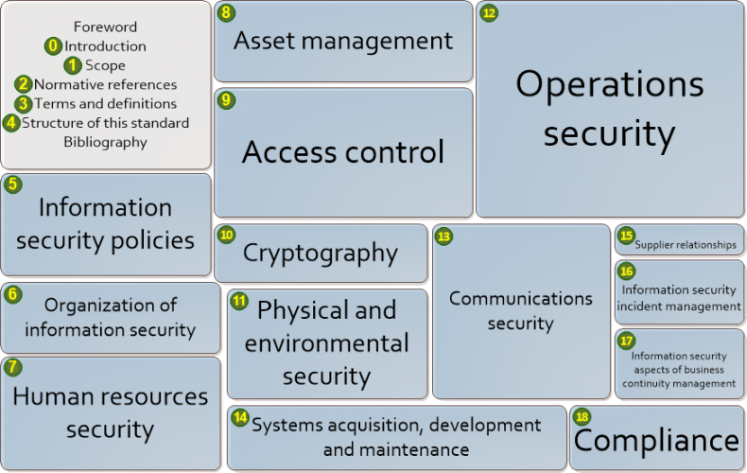
How to Use ISO27002:2013
STRUCTURE OF ISO27002:2013
http://www.iso27001security.com/html/27002.html

Slide 5
How to Use ISO27002:2013
Lets have a look at control A.5.1.2 (Review Of The Policies Of Information Security)

Slide 6
How to Use ISO27002:2013
ISO27001:2013
A.5.1.2 | REVIEW OF THE POLICIES FOR INFORMATION SECURITY | Control: The policies for information security shall be reviewed at planned intervals or if significant changes occur to ensure their continuing suitability, adequacy and effectiveness.

Slide 7
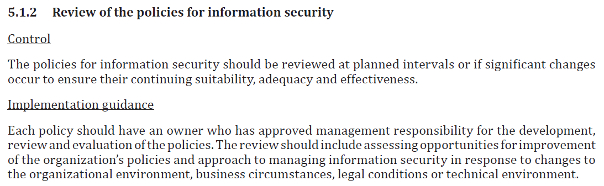
How to Use ISO27002:2013
ISO27002:2013
TITLE

Slide 8
How to Use ISO27002:2013
ISO27002:2013
CONTROL

Slide 9
How to Use ISO27002:2013
ISO27002:2013
27002 IMPLEMENTATION GUIDANCE

Slide 10
How to Use ISO27002:2013
ISO27002:2013
A.5.1.2 | REVIEW OF THE POLICIES FOR INFOSEC | 27002: Implementation Guidance: Each policy should have an owner who has approved mngmt responsibility for the development, review and evaluation of the policies. The review should include assessing opportunities for improvement of the org’s policies and approach to managing Infosec in response to changes to the org environment, business circumstances, legal conditions or tech environment.

Slide 11
How to Use ISO27002:2013
Practically:
ISO27001:2013 controls are brief and generic
27002 clarifies further what is being referred to, gives further context & very useful implementation guidance
END

